Slide 1
Intelligent enterprise systems and ai application in military
1.Ahmed Mohamed Omar – sct221-0344/2017
2. Ngurwa Florence Wanja – SCT221-0122/2017
3. Yvonne Mutua – SCT221-0109/2017
4. Clare Chebet – SCT221-0106/2017
5. Isaac Munene – SCT221-0431/2017

Slide 2
INTELLIGENT ENTERPRICE APPLICATION.
The term "Intelligent Enterprise" refers to a management approach that applies technology and new service paradigms to the challenge of improving business performance.
Recently Ai application of intelligent enterprise application include:
Transferring and cross-referencing data; updating files
Consumer behavior forecasting and product recommendations
Fraud detection
Personalized advertising and marketing messaging
Customer service via telephone or chatbots
Harvard Business Review reports that AI stands to make the greatest impact in marketing services, supply chain management, and manufacturing.

Slide 3
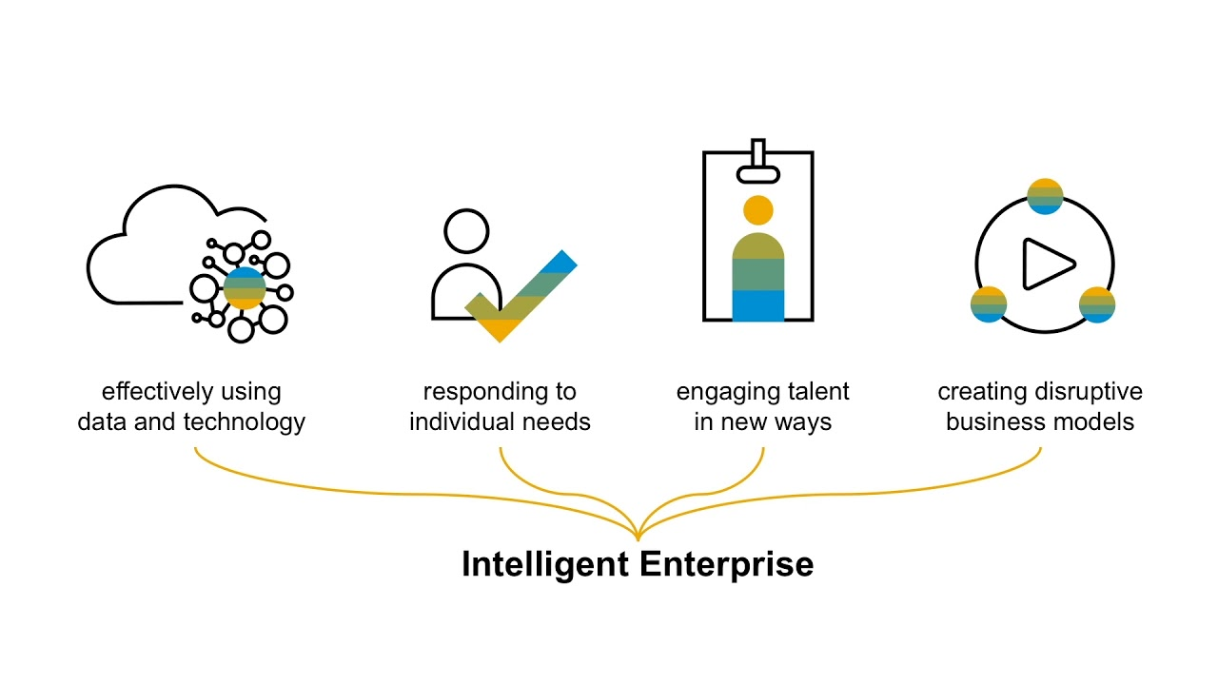
The IE differentiates between three key capabilities:
Visibility: The ability to collect and connect data that was previously siloed to recognize patterns
Focus: The ability to simulate potential options and direct scarce resources to the areas of maximum impact
Agility: The ability to adapt business processes in response to changing market condition, in real time

Slide 4
A framework comprising three components
The intelligent suite: To enable automation of day-to-day business processes and better interaction with customers, suppliers, and employees through applications that have intelligence embedded
The digital platform: To facilitate the collection, connection, and orchestration of data as well as the integration and extension of processes in integrated applications
Intelligent technologies: To enable leveraging data to detect patterns, predict outcomes, and suggest actions
Examples of AI in Business Intelligence Applications
DOMO – AI for Business Dashboards- its a fast-growing business management software company created a dashboard that gathers information to help companies make decisions and to pull data from Salesforce, Square, Facebook, Shopify
Apptus – AI in Sales Enablement: The software combines big data and machine learning to determine which products might appeal to a potential customer as they search online or get recommendations.
Avanade – AI for Business Insights; . The goal was to use customer and policy data to help the team drive more growth.

Slide 5
Challenges Facing Enterprise Applications.
Security-Most enterprise applications, especially mobile applications, are not secured by the organizations that own them due to attackers threats
User interface and limitation of skills-on how the system works
Integration challenges-lack of knowledge of the integration process.
Solution;
Emphasis on intuitiveness(usability ) rather than aesthetics
Better implantation strategies
Online research paper writing help to handle enquires.

Slide 6
military.
Applications
-- Army to test AI
-Shooting down drones- South Korea is known to have used the armed SGR-A1 sentry robot, which has operated in the demilitarized zone separating North and South Korea.
Aiming tank guns
Coordinating resupply and maintenance
Planning artillery barrages
Blending sensor feeds together into coherent picture
Analyzing how terrain blocks units’ fields of fire
Warning commanders where there are blind spots in their defenses

Slide 7
REFERENCE
Joao-Pierre Ruth, Last updated on November (21, 2019)
Tejaswi Singh and Amit Gulhane, on (October 3, 2019)
Kirsten Gronlund ,May (9, 2019)
http://www.webopedia.com/TERM/E/enterprise_application.htm
http://www.calero.com/3-critical-challenges-facing-enterprise-mobility-in(2019)

